Slide 1
SLAM
Algorithms
EDAA — G06
João Martins
Henrique Ribeiro — João Costa
Tiago Duarte

Slide 2
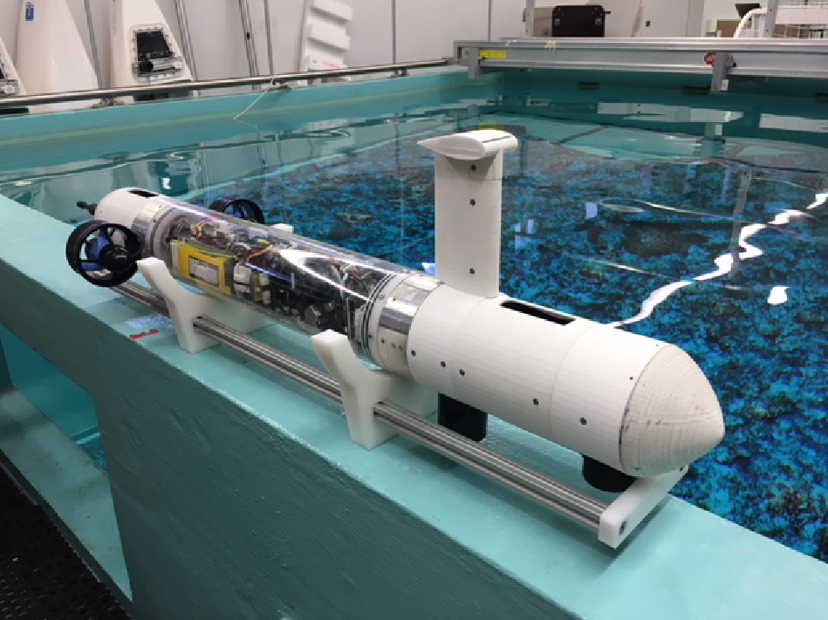
Simultaneous Location And Mapping
Goal – map an environment navigated by and autonomous vehicle, while simultaneously locating it in the map;
Challenges:
No access to pre-existing maps or external devices;
Focus on sub-aquatic SLAM ⇒ difficult access and extra data noise;
Datasets – the group will have access to sonar data measured by CRAS.
Fig 1. UAV used to collect the datasets.

Slide 3
Roadmap
Probabilistic Mapping Problem
Small recap of sonar data
Probabilistic mapping
Edge detection
Simple threshold approach
Canny filter
Noise Reduction Methods
Computer vision similarities
Kalman filter
Raycast Algorithm
Bresenham's line Algorithm

Slide 4
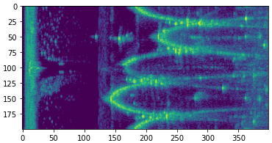
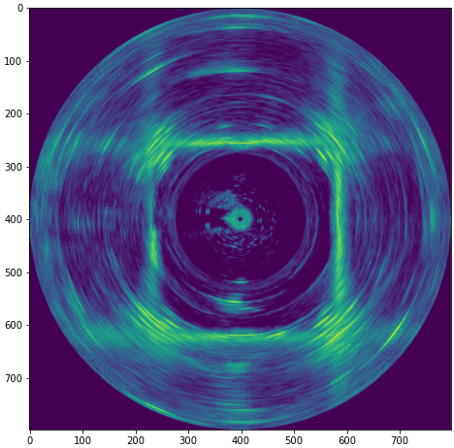
Sonar data
A sonar mounted on a vehicle collects environment data;
Sonar data contains noise and other undesirable effects (e.g. multipath);
Fig 2. Illustrates the raw data of the sonar and the problems present in this data:
Reflections from the body of the vehicle (self reflections);
Multipath effects when signals go through the tank walls;
Noise affecting detection of features (e.g. tank walls and floater).
It is important to clean this data and find the distance to the first feature for each measurement.
Fig 2. Dataset representation in polar and Cartesian coordinates.

Slide 5
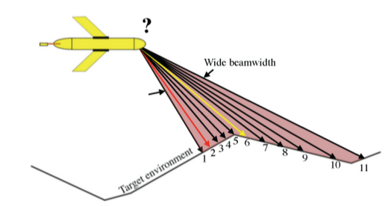
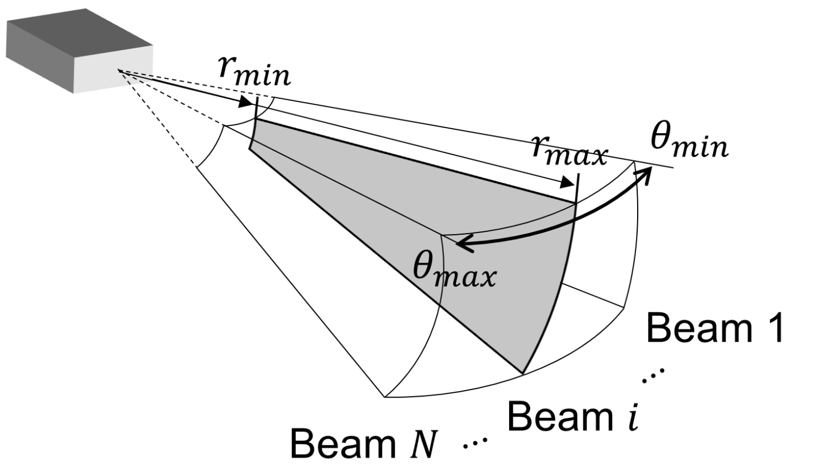
Sonar Data
Sonar rotates around itself
Sends/measures waves in a cone
But we will only consider the 2D problem in this first part
Each beam has multiple intensities across several intervals
Fig 3. Sonar beam representation 2d [PAPER]
Fig 4. Sonar beam representation 3d [PAPER]

Slide 6
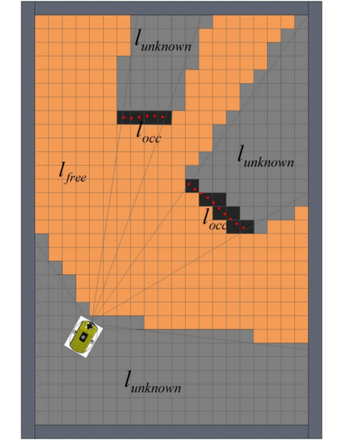
Map updates
Find the first obstacle that a ray intersects
Update values that we know that aren’t occupied
How do we update the probabilities?
How do we find cells that the beam intersects?
How do we detect that we’ve hit an obstacle?
Fig 5. Sonar data in polar and Cartesian coordinates
Fig 6. Beam cast representation[1]

Slide 7
Probabilistic Mapping

Slide 8
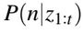
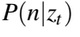
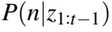
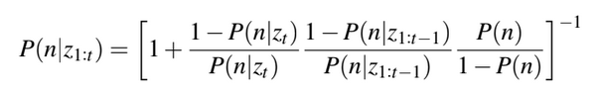
Probabilistic Mapping [2]
Use conditional probabilities to update map
Using Bayes theorem, we can deduce:
Fig 7. Probability that cell is occupied given all measurements
Fig 8. Probability that cell is occupied using last measurement
Fig 9. Probability that cell is occupied from past measurements
Fig 10. Probability update formula

Slide 9
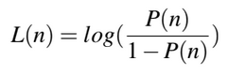
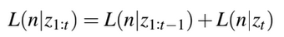
Probabilistic Mapping [2]
Fig 11. Probability update formula
Which can be converted to log-odds notation:
More efficient – Reduces multiplications/fractions
Fig 12. Probability update formula in log odds
Fig 13. Log odds formula

Slide 10
Map updates
Find the first obstacle that a ray intersects
Update values that we know that aren’t occupied
How do we update the probabilities?
How do we find cells that the beam intersects?
How do we detect that we’ve hit an obstacle?
Fig 5. Sonar data in polar and Cartesian coordinates
Fig 6. Beam cast representation [1]

Slide 11
Raycasting Algorithms

Slide 12
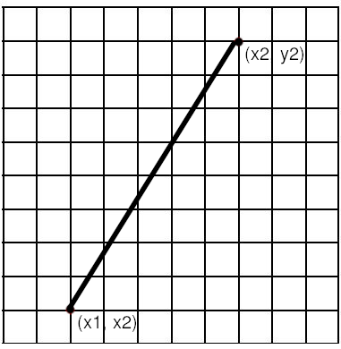
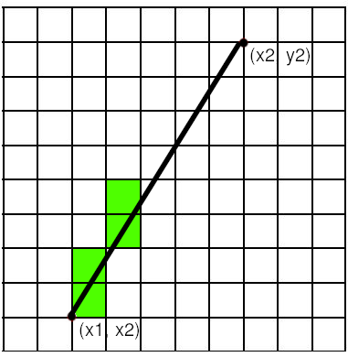
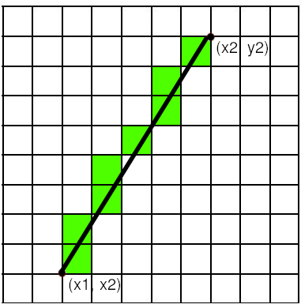
Raycasting
Given two points that form a line:
Find which cells map to it
Update cell probabilities
Fig 14. Raycasting visualized

Slide 13
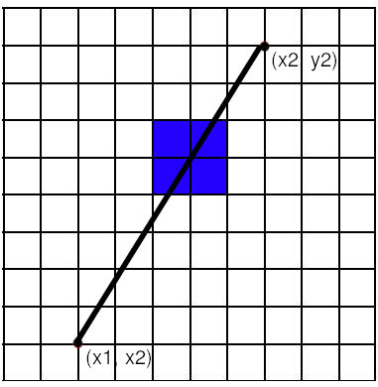
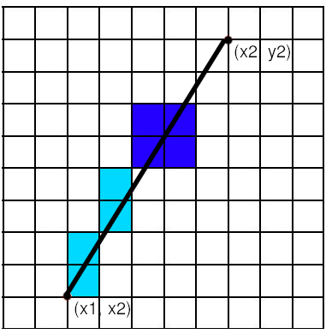
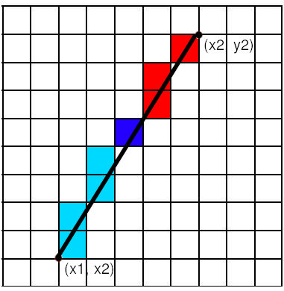
Raycasting
Detect an intersection with an object → Edge detection
Update cell probability
Cell is before object → free
Cell holds object → occupied
Cell is after object → unknown
Fig 15. Using raycasts to identify cells behind/in front of obstacle

Slide 14
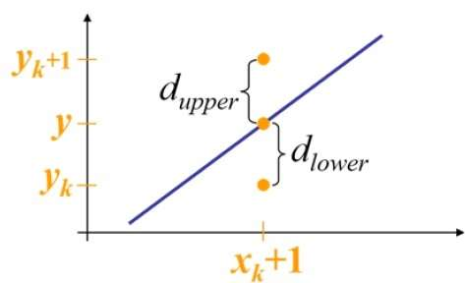
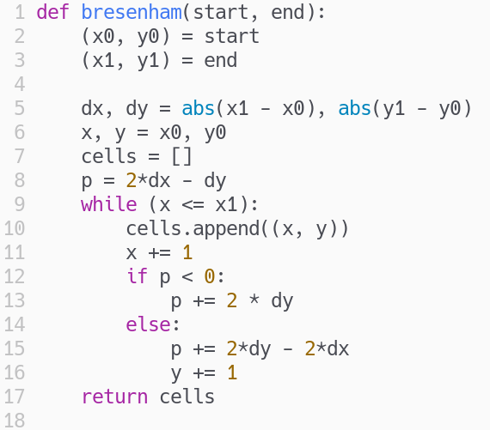
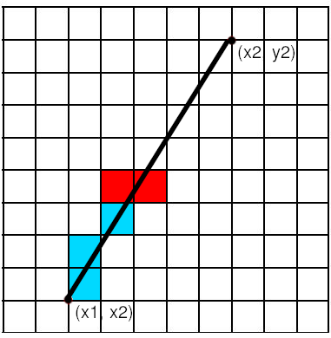
Bresenham’s Line Algorithm
Select closest cell to the line based on error
Error is calculated with dx and dy values
Fig 17. Cell distances from decision point
Fig 16. Bresenham Algorithm
Fig 18. Bresenham’s line Algorithm - Decision visualized

Slide 15
Map updates
Find the first obstacle that a ray intersects
Update values that we know that aren’t occupied
How do we update the probabilities?
How do we find cells that the beam intersects?
How do we detect that we’ve hit an obstacle?
Fig 5. Sonar data in polar and Cartesian coordinates
Fig 6. Beam cast representation [1]

Slide 16
Edge Detection

Slide 17
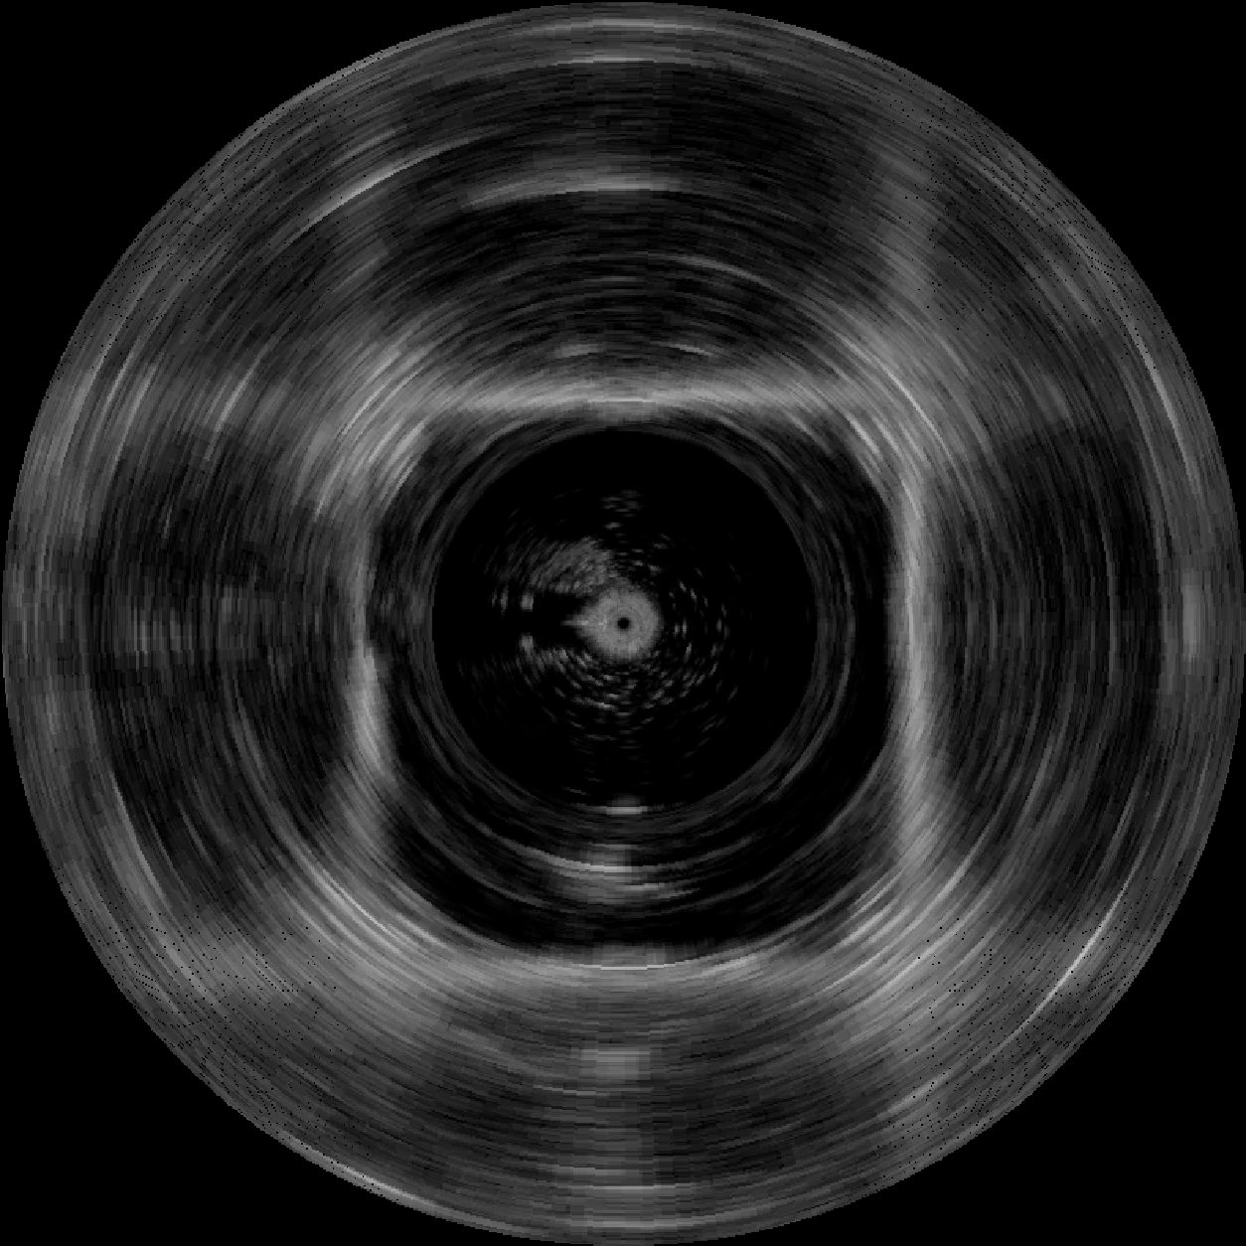
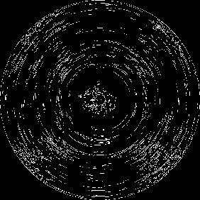


Canny Filter [3]
Uses two thresholds and edge tracking by hysteresis
Necessary to find the best combination of thresholds
Increased blur provides best results
Fig 19. Original scan.
Fig 20. Original scan with canny filter.
Fig 21. Blurred scan.
Fig 22. Blurred scan with canny filter.

Slide 18
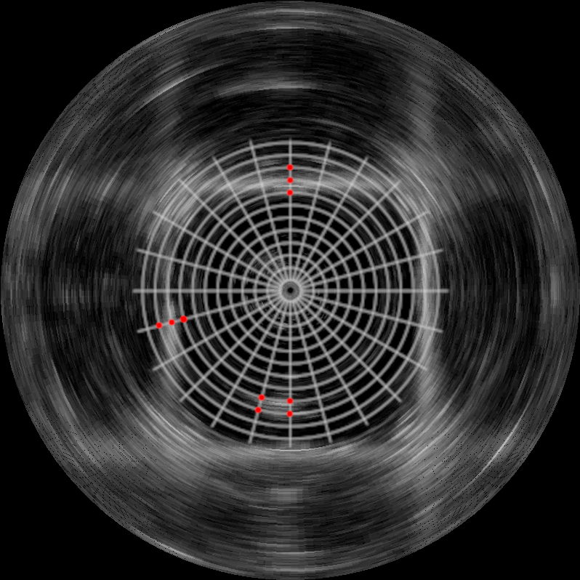
Simple threshold approach [2]
Calculate variation of intensities
Define a threshold
Variations above that threshold approach
Increased blur provides best results
Fig 23. Original Image
Fig 24. Scan with identified edges using simple threshold approach

Slide 19
Canny Filter
Simple Threshold
Produces better results
Easier to implement
01
01
Harder to tune
Sensitive to noise
02
02
Less flexible
03

Slide 20
Noise Reduction Methods

Slide 21
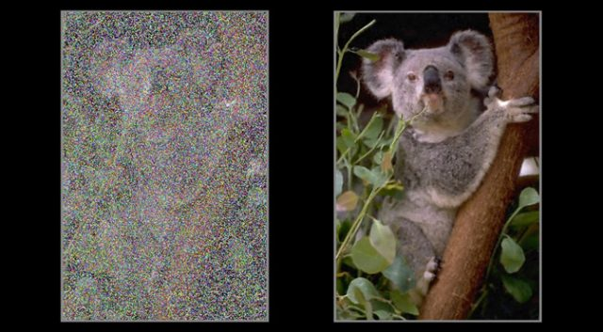
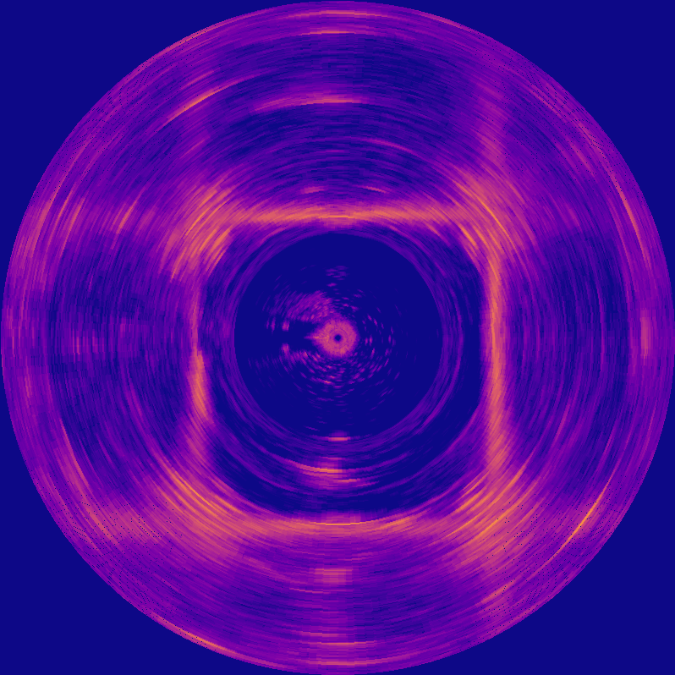
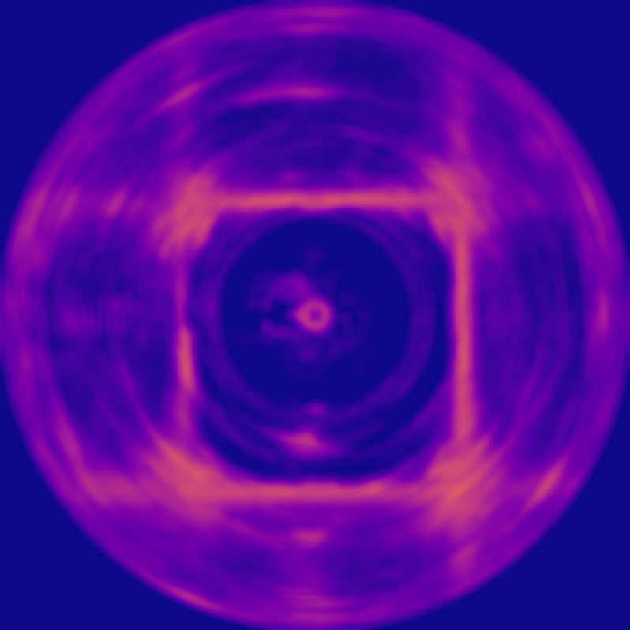
Computer Vision Similarities [4][5]
Consider sonar data as a one channel image that has noise
Treat noise with computer vision algorithms
Fig 25. Image with and without noise
Fig 26. Sonar data with noise and with reduced noise

Slide 22
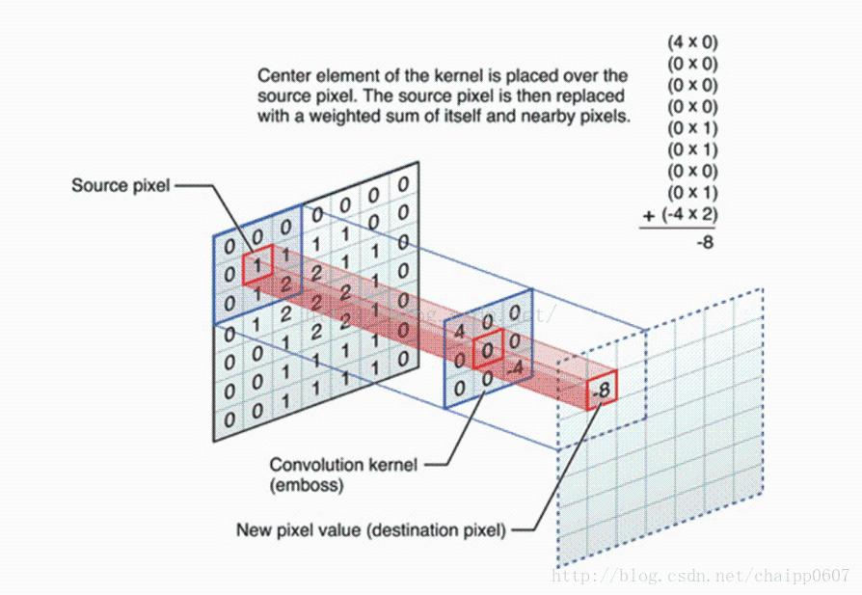



C.V. Smoothing Filters
Use blurring to reduce noise
Improves drastically edge detection
Fig 31. Convolution visualized
Fig 27. Dataset representation in Cartesian coordinates.
Fig 28. Gaussian filter
Fig 29. Median filter
Fig 30. Mean filter

Slide 23


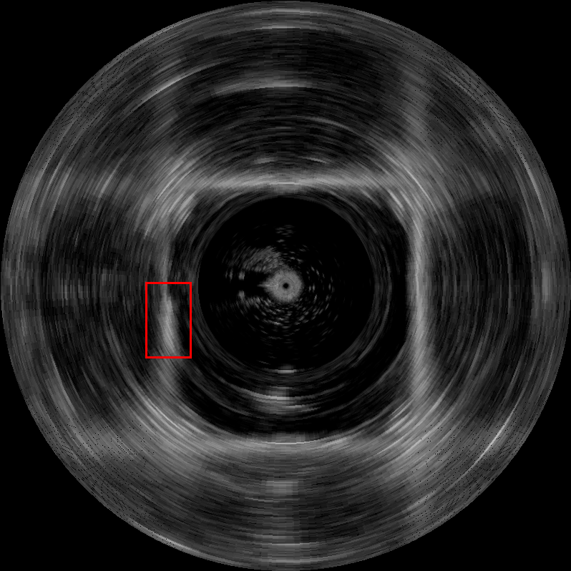


C.V. Smoothing Filters
Fig 33. Original selection
Fig 34. Gaussian
Fig 35. Median
Fig 36. Mean
Fig 32. Original scan image

Slide 24
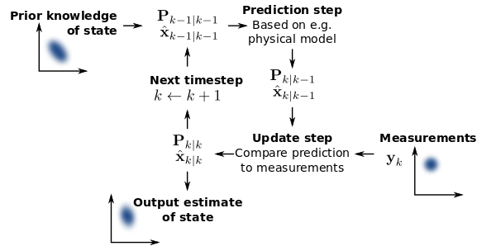
Extended Kalman Filter
Define the system state - A full sonar scan
Define model - function describing sonar/environment movement
Derive new state from measurements and estimation
Measurement - New sonar scan (new state)
Estimate - From function and old state
Estimate new state from measurements and previous state
Fig 37. Kalman filter algorithm visualize [6]

Slide 25
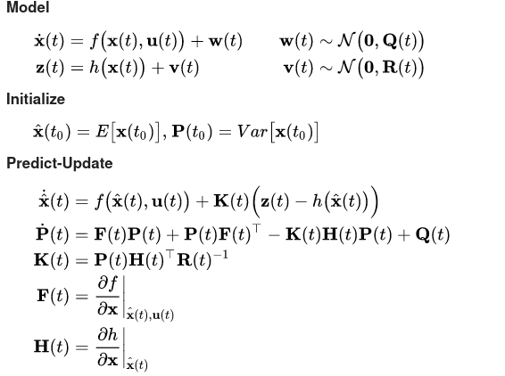
Extended Kalman Filter - Problems
Need to derive model from a set of feature points
Need to extract these points from data and identify them properly
Complex problem - Requires line and corner detection
Part of the localization part
Out of scope for this project
Movement function must be linear
Requires Taylor series to linearize the model
Fig 38. Kalman filter steps described [6]

Slide 26
E.K.F.
Gaussian Filter
Much more accurate
Easier to implement
01
01
Requires feature point extraction
Doesn’t take movement into account
02
02

Slide 27
Efficiency Challenges
Algorithms need to run under some constraints
40 ms per beam
200 beams per scan
Noise reduction algorithms need a full scan to work
For instance, smoothing filters and E.K.F.
Possible efficiency/accuracy tradeoffs

Slide 28
References
[1] - Real Time Obstacle Detection in a Water Tank Environment and its Experimental Study - Ji-Hong Li, Mun-Jik Lee, Won-Seok Lee, Jung-Tae Kim, Hyung-Joo Kang, Jin-Ho Suh
[2] - Underwater mapping using a SONAR - João Fula
[3] - Bottom Tracking Method Based on LOG/Canny and the Threshold Method for Side-scan Sonar - Shengping Wang, Hongtao Li, Xiaoyu Li, Jiansong Yang and Quanhong Feng
[4] - Automatic target detection of sonar images using multi-modal threshold and connected component theory - Subhra Kanti Das, Soma Banerjee, Dibyendu Pal, Sambhunath Nandy, Sankar Nath Shome & Somnath Mukherjee
[5] - Techniques adopted in the post processing of active sonar data from Royapuram
site-off Chennai - Mahimol Eldhose, Dhilsha Rajapan, Shijo Zacharia, D.S. Sreedev & M. A. Atmanand
[6] - Kalman Filter - Wikipedia

Slide 29
Questions?

